Slide 1
KP Dispense Investigation Report

Slide 2
Issue Definition
What We Know
Root Cause Analysis
Data Analysis
Summary and recommendations
Tests
Test Conclusions
Recommendations

Slide 3
Issue Definition
The rate of KP dispense inaccuracies has been on the increase in the month of May and June.
This report presents analysis to identify possible root-causes and solutions that can be implemented to reduce the rate of non-conformance.
This report also links to the KP Performance Tests Report

Slide 4
What we know
24%(77) of KPs verified after 3 months failed.
47 out of the 77 failed because of over dispensing in 2L alone.
From 13th March to 4th June, there has been 93 reported dispense accuracy issues escalated for investigation.
46 of the 93 issues has been due to over dispensing while 26 is due to under dispensing.
14KPs have two reported dispense inaccuracy incidents while 3KPs have three incidents.
In the month of May and June, total number of inaccurate dispense issues escalated for investigation were 163.

Slide 5
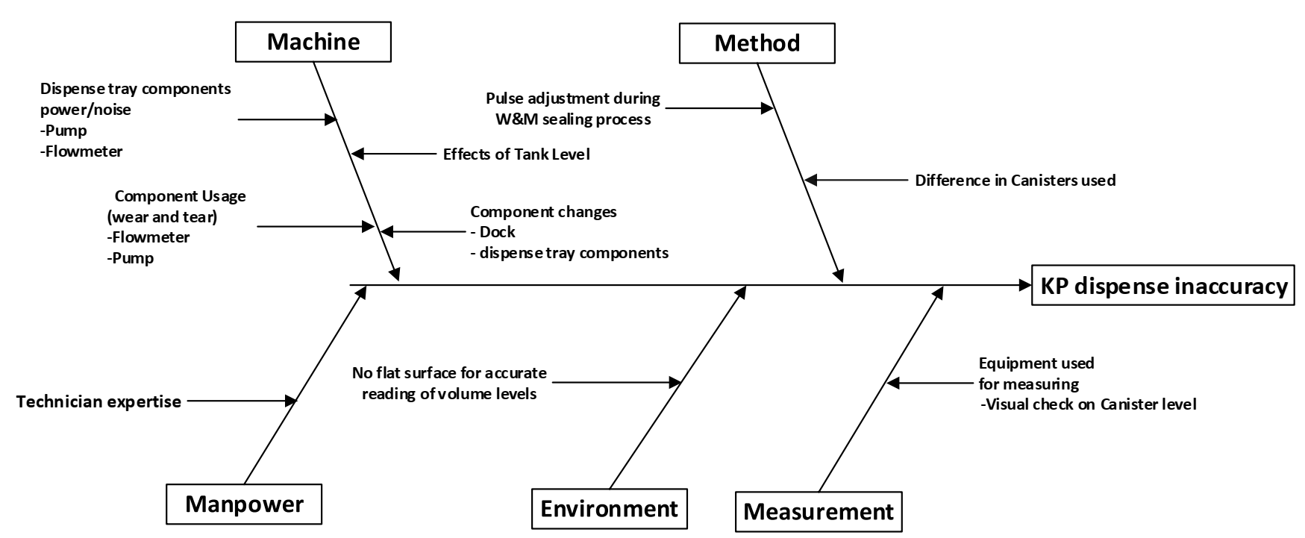
Root Cause Analysis

Slide 6
Prioritization Matrix
 | Potential Root Cause | Probability of occurrence | Severity level | Ease of detection | Cumulative scale
1 | Dispense tray component power/noise | 3 | 4 | 3 | 36
2 | Dispense tray components usage (wear and tear) | 2 | 5 | 3 | 30
3 | Effects of tank level | 2 | 4 | 3 | 24
4 | Pulse adjustments during/before W&M sealing | 2 | 2 | 4 | 16
5 | Difference in canister's properties | 2 | 3 | 2 | 12
6 | KP Component changes | 2 | 3 | 2 | 12
7 | Equipment used during visual measuring process | 2 | 4 | 1 | 8
8 | No flat surface for accurate reading by maintenance personnel | 2 | 3 | 1 | 6
9 | Technician expertise | 1 | 2 | 2 | 4

Slide 7
Analysis Action Items
Group KPs according to K factors for monitoring [link].
Analyze KPs that passed the 3 month verification to see past pulse adjustments [link].
Compare flowmeter QC K factors to the current calibration K factors to observe trends if any.[link]
Analyze the change in dispense volumes from calibration to 3 month verification to observe trends.[link]
Analyze KPs that passed the 3 month verification to see past history on verifications.[link].
Identify any component changes on the KPs verified at 3 months.[link]

Slide 8
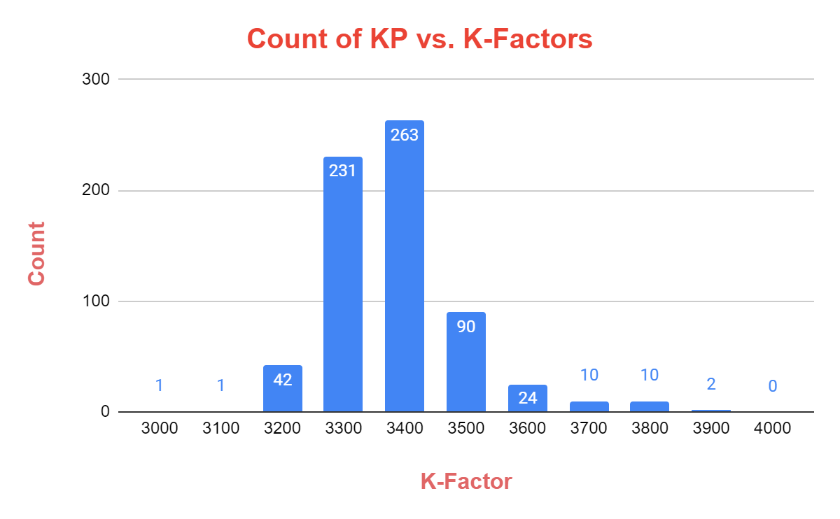
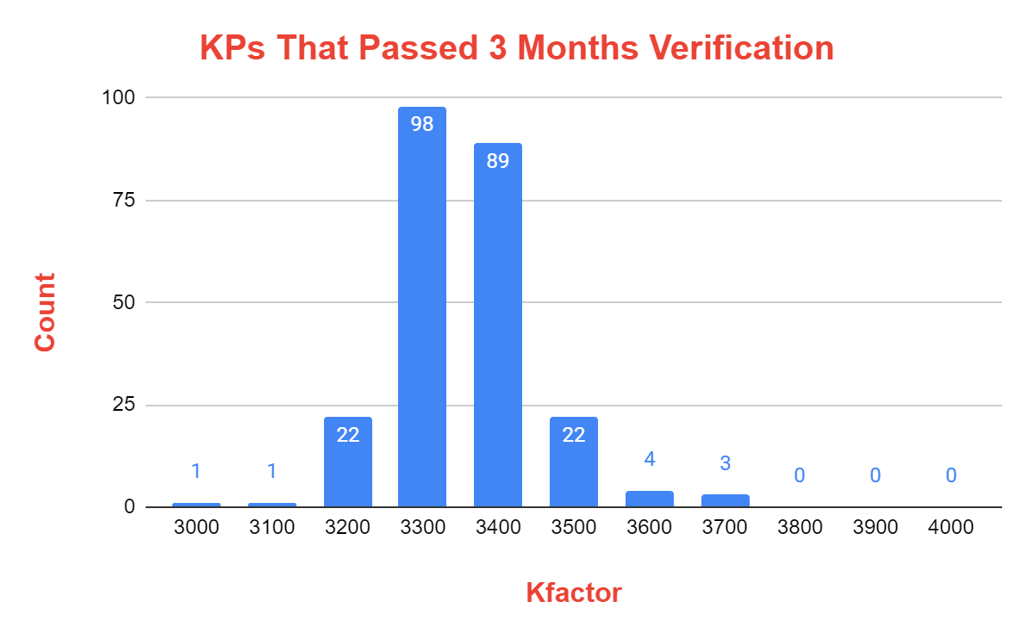
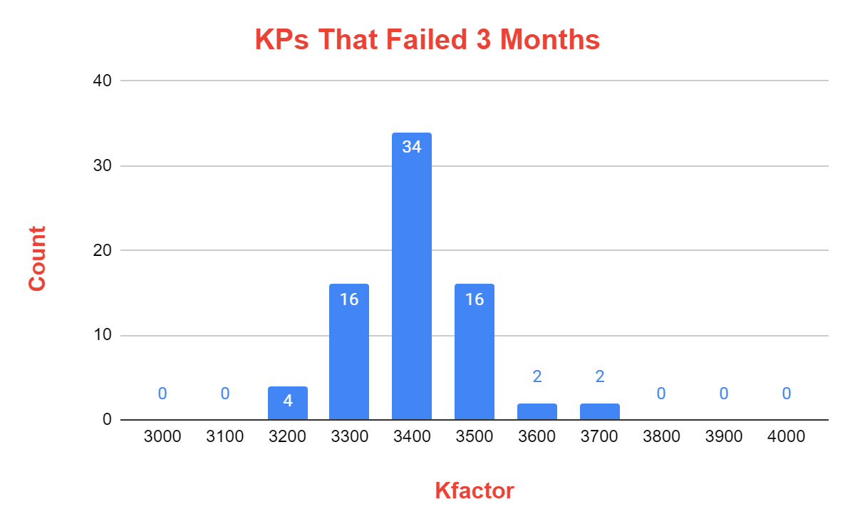
Analysis
Grouping of KPs according to FMK(flow meter K factors)
66 out of 674 KPs are out of manufacturer’s recommended FMK range
The spread of KPs across the FMK range 3000 to 3900 is relatively the same in KPs that failed or passed 3 months verification

Slide 9
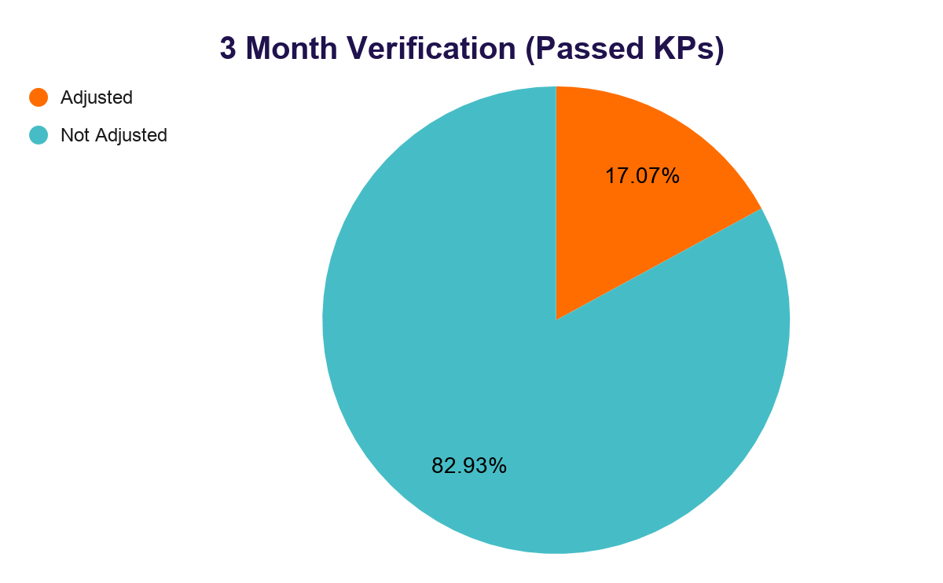
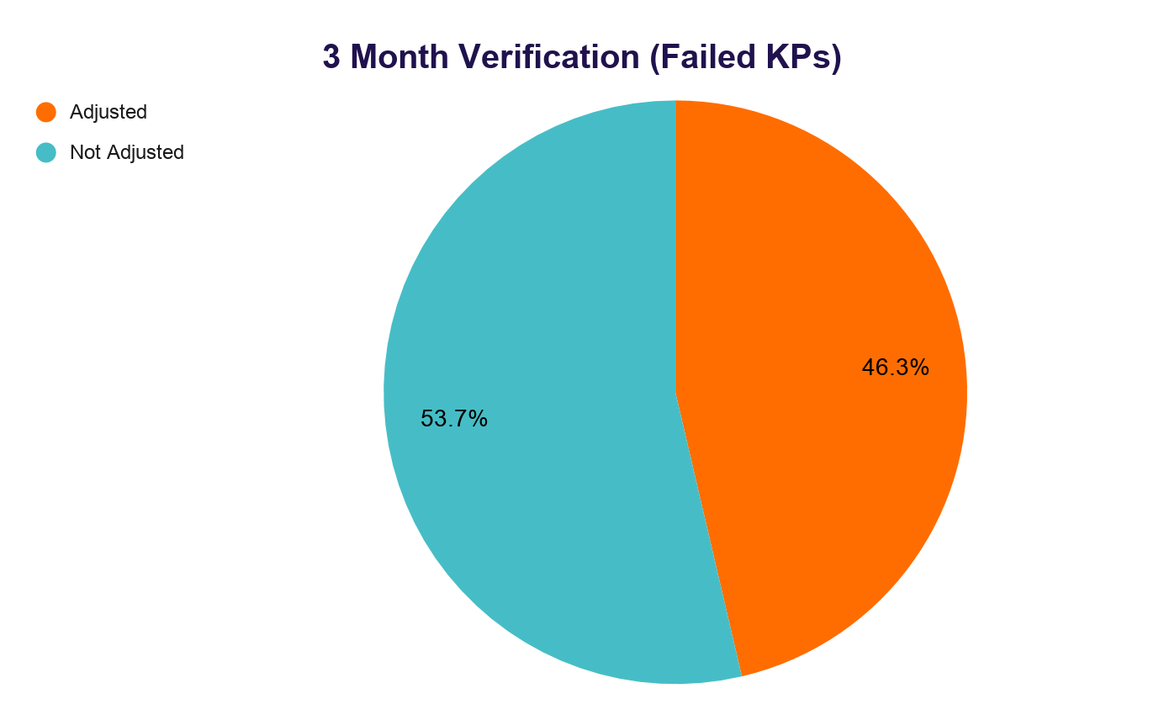
Analysis
Grouping KPs according to pulses adjustments /calibrations done before W&M sealing
KP’s that failed 3 month verification have a higher rate of pulse adjustment or calibration before W&M sealing

Slide 10
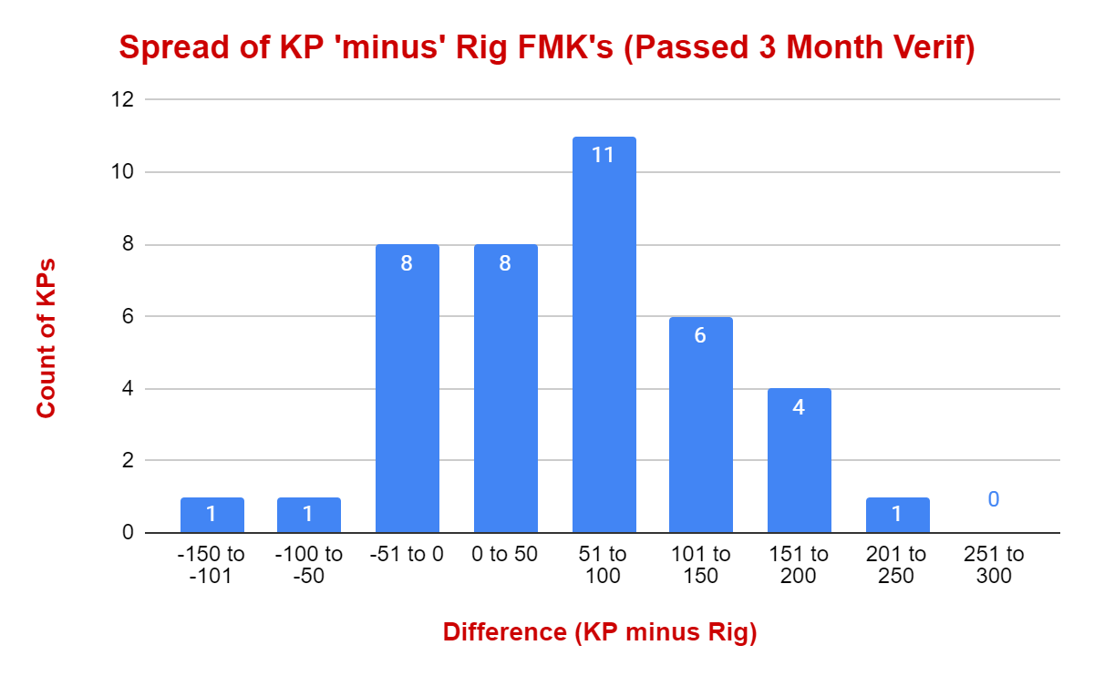
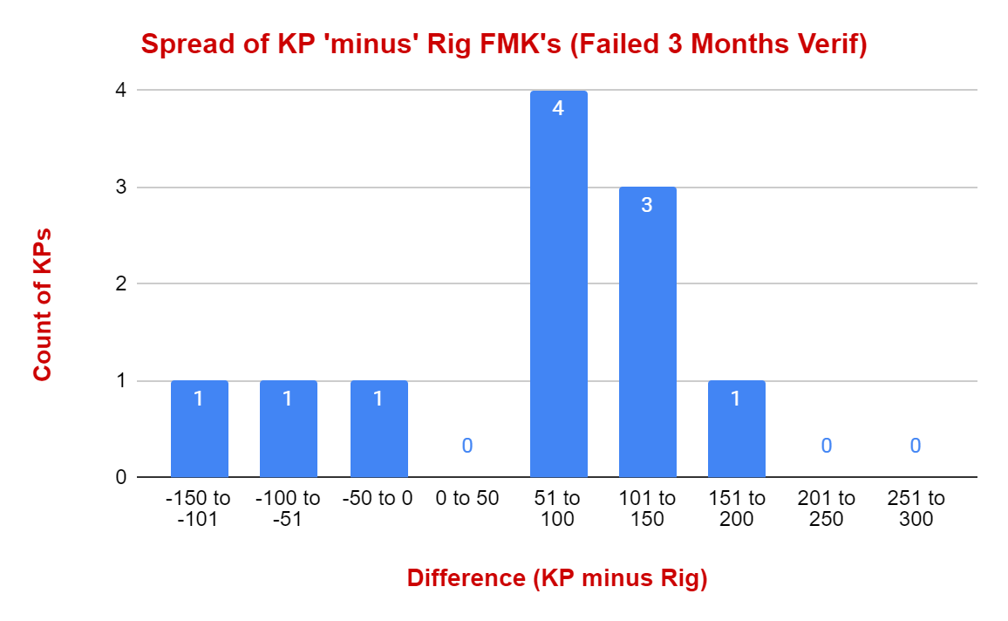
Analysis
KP FMK vs Flowmeter test rig FMK
There is no a certain difference between the flowmeter’s FMK on a test rig and on the KP

Slide 11
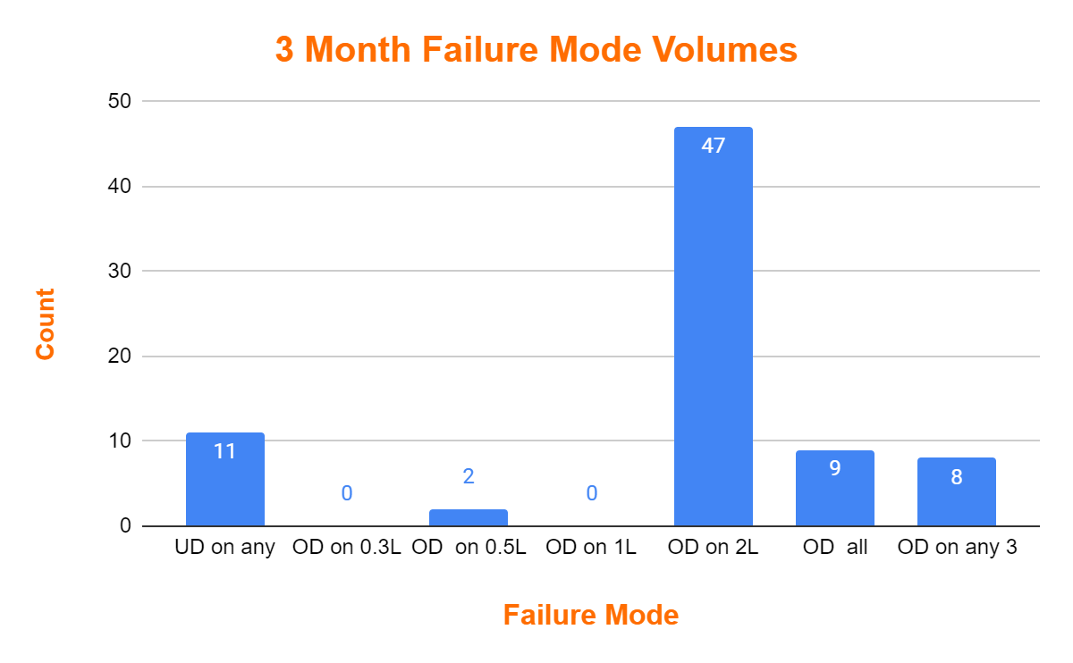
Analysis
3 Month verification failure mode
Over dispense: 63
Under dispense:14
2L Dispense Volumes for 3 Month Failures
2020 to 2030 | 28
2031 above | 29
OD=Over dispense
UD=Under dispense
47 out of the 77 KPs failed because of over dispensing in 2L only
Data Source: Calibration Accuracy Verification Results

Slide 12
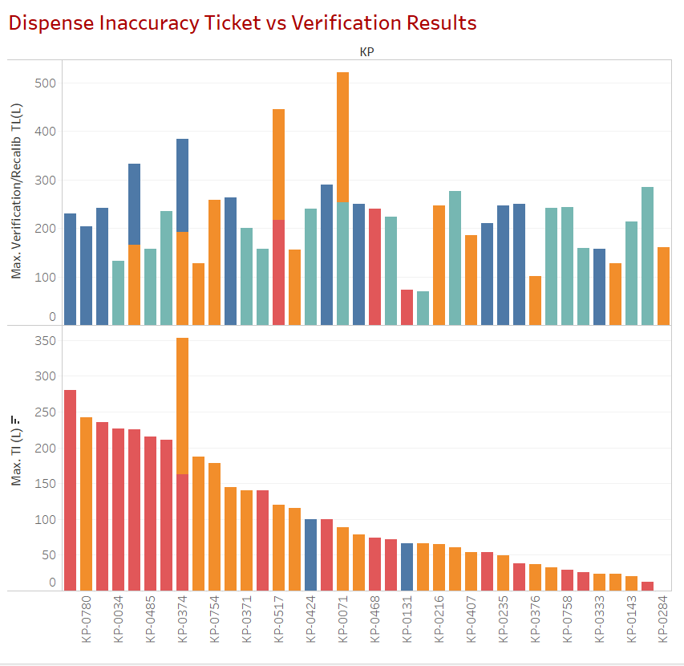
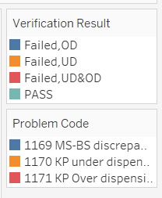
Dispense Investigation Tickets Analysis
Total Tickets: 75
OD: 42
UD: 32
Others:1
Results
Verified: 43
Passed:15
Failed: 28
OD:13
UD:12
Mixed UD&OD:3
Of the 75 affected KPs;
73% sealed by W&M, 27% SG
27 passed 3 months verification
11 failed.
Only 4 in each category passed verification
Data Source: Calibration Accuracy Verification Results Upto 4th June

Slide 13
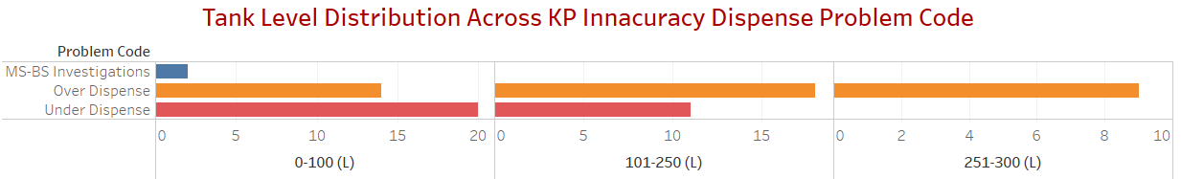
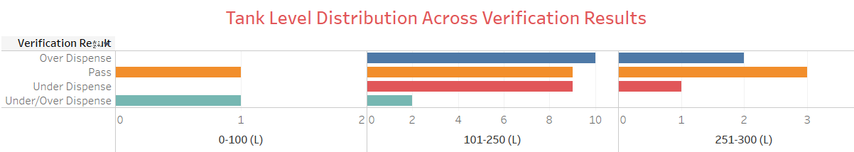
Tank Levels Analysis
Both Over Dispense and Under Dispense problem codes appear nearly in all TL categories.
Data Source: Calibration Accuracy Verification Results

Slide 14
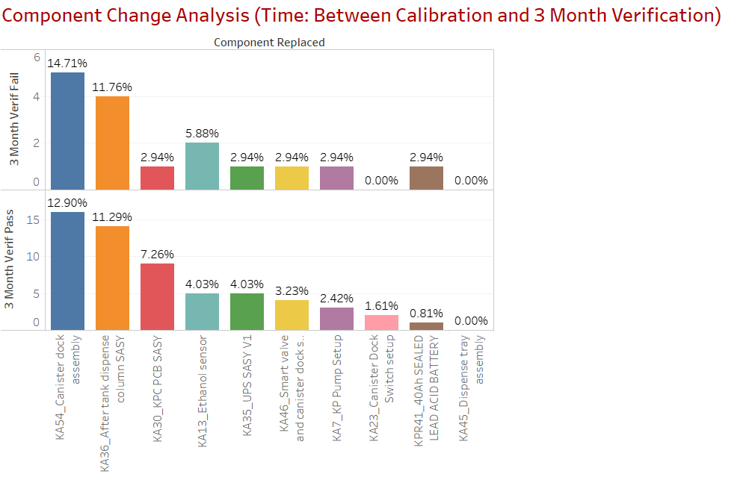
Component Changes
Component change rate (%) is approx’ the same between the KPs that failed or passed 3 months verification.
Therefore, component change has negligible contribution to KP dispense accuracy non-conformance
Data Source: Defective Items Database upto 5th May 2020

Slide 15
Conclusions & Further Tests
The following can be concluded to have no direct relation to the KP dispense inaccuracy incidents reported;
Pulse adjustments/re-calibration prior to W&M sealing
Component changes
Tank level
Tests
Test dispense tray components power and noise performance.
Test flowmeter K-Factors at different flowrates to compare with manufacturer specs

Slide 16
Test Setup 1- DV, Pump and FLM Wear & Tear Test
Objective
Test effects of component wear and tear to dispense accuracy and current consumption
Setup
New DV, pump and flowmeter connected to a bench power supply powered test rig. Configured to dispense 1L in every 3 minutes and 3X1L dispenses measured in the morning and in the evening to obtain dispensed volume and flowrate

Slide 17
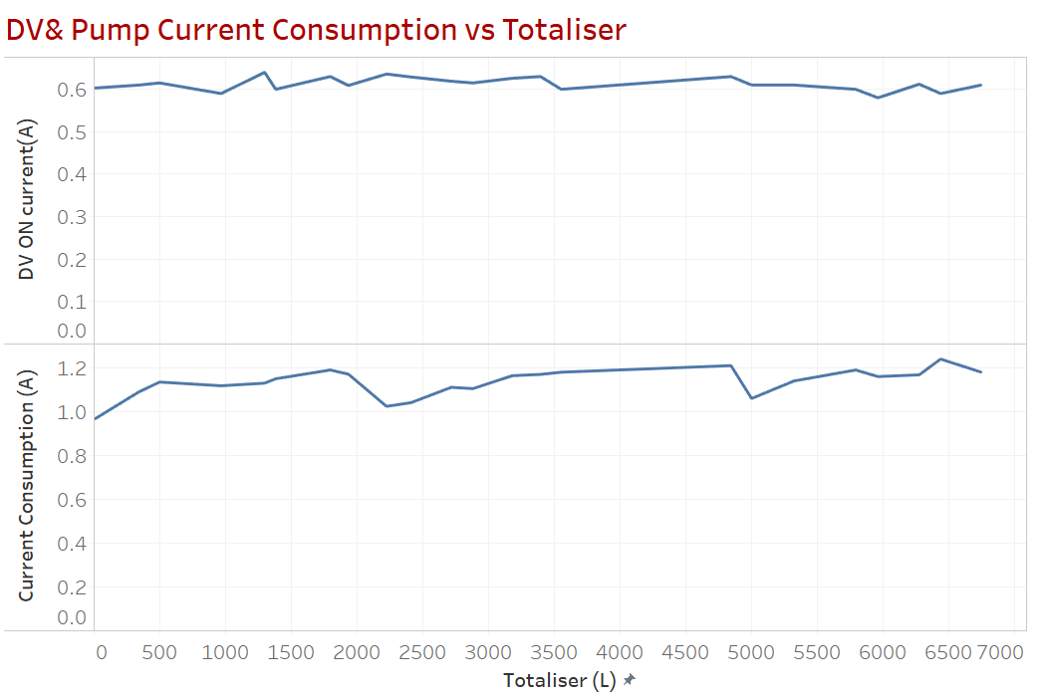
Test Setup 1 Results
Dispense Tray Components Wear & Tear
Total Vol Dispensed (L): 6747
Current drawn by DV remains nearly constant throughout the test
Current drawn by the pump remained between 1.0 and 1.2A during the test.

Slide 18
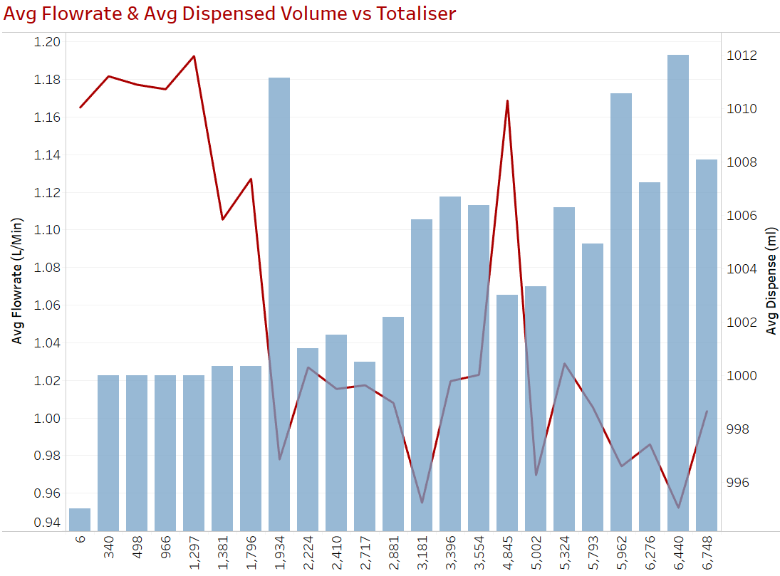
Test Setup 1 Results
Dispense Tray Components Wear & Tear
Average flowrate decreased towards the end of the test (0.9 - 1.0 LPM vs 1.18 when starting)
Average dispense volume increased towards the end of the test ( 1007ml vs 1000ml when starting)
There was an average 38 pulses decrease in FMK towards the end of the test (3350 to avg 3312)
DV was observed to close completely at the end of the test
NB: FMK: Flowmeter K-Factor, pulses equivalent to 1L

Slide 19
Test Setup 2- Flowmeter performance vs flowrates(TL)
Objective
Test the KP flowmeter FMK(K-factor) across varying flowrates as a results of different KP tank levels
Setup
2 KPs with SS Smart valves were calibrated at 70L and topped upto 300L.
3X1L dispenses were done to obtain dispensed volume and flowrates after which 20L was drained and the 3X1L dispenses repeated till <15L TL. FMK was projected using the average dispense accuracy.
This was repeated for 150L and 300L calibration points.
Test was repeated with the flowmeter powered by 12V DC
NB: TL - KP Tank Level

Slide 20
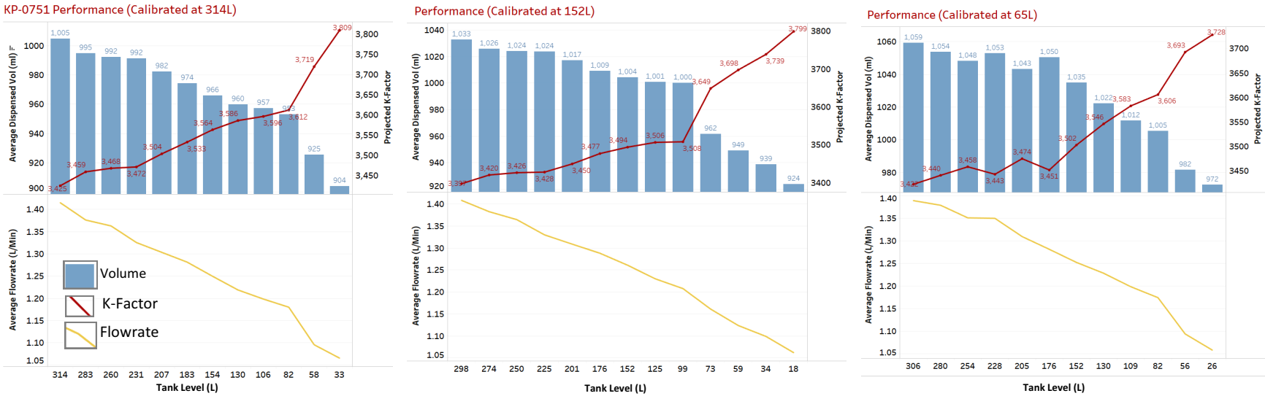
Test Setup 2 Results, KP-0751
NB: KP-0751 has dispensed over 7000L in previous tests
FMK increases with decrease in TL
Dispensed volume decreases with decrease in TL/Flowrate
FMK is change is greater when the KP is calibrated at 152L (402 pulses) and least at 70L (306 pulses).

Slide 21
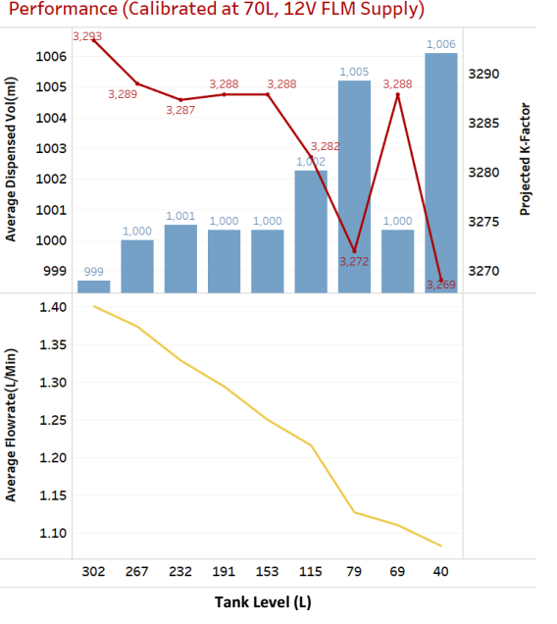
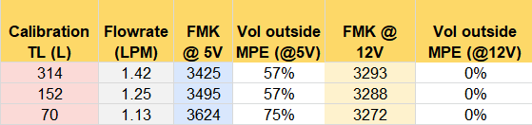
Test Setup 2 Results, KP-0751
FMK averagely decreases with decrease in TL/Flowrate - dispensed volume increases with decrease in TL.
None of the volumes dispensed were out of MPE spec (1000+-20ml).
In the 12V setup, the KP has a lower FMK (3289) compared to the normal 5V setup (3425, 3495, 3624).
In the 12V setup, the change in FMK is very minimal compared to 5V setup

Slide 22
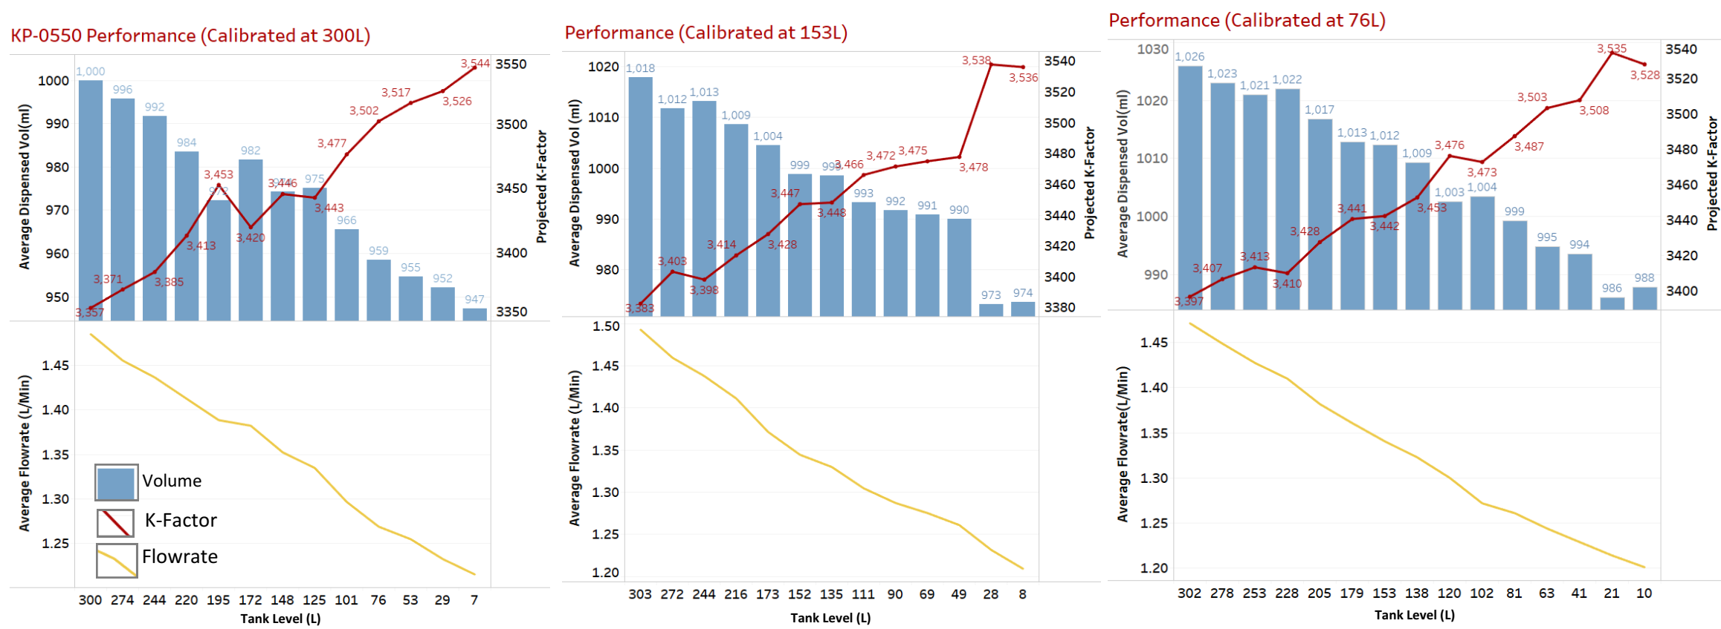
Test Setup 2 Results, KP-0550
NB: KP-0550 has a new pump and DV (reworked tray)
FMK increases with decrease in TL
Dispensed volume decreases with decrease in TL/flowrate
FMK is change is greater when the KP is calibrated at 300L (187 pulses) and least at 76L (41 pulses).

Slide 23
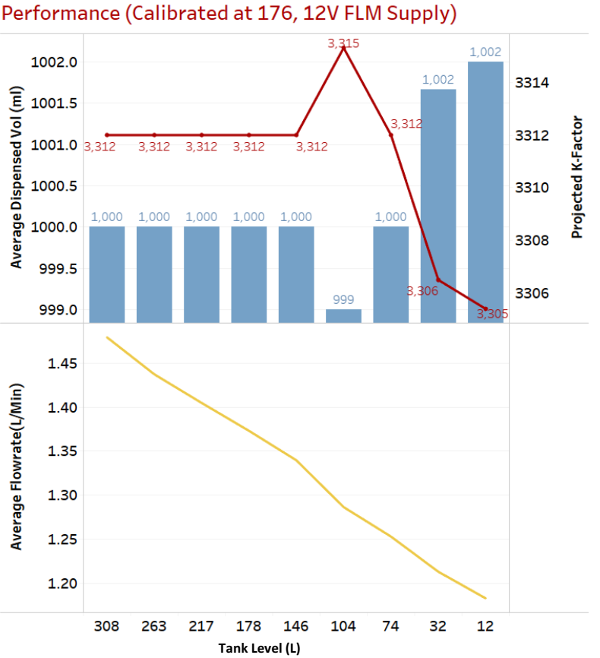
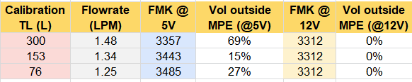
Test Setup 2 Results, KP-0550
FMK averagely increases with increase in TL(Flowrate) - dispensed volume increases with decrease in TL.
None of the volumes dispensed were out of MPE spec (1000+-20ml).
In the 12V setup, the KP has a lower FMK (3312) compared to the normal 5V setup (3357, 3443, 3485).
In the 12V setup, the change in FMK is very minimal compared to 5V setup

Slide 24
Test Setup 3- Component Power & Noise Test
Objective
Test whether the KP pump is a possible noise source in the dispense process.
Setup
An external relay circuit was prepared to power the KP pump from a 12V UPS (KP UPS) when actuated by the KP circuit.
A KP with the S.S SmartValve was calibrated at 300L, fuel drained in 20L steps after 3X1L dispenses to obtain flowrate, dispensed volume and project the FMK.
NB: TL - KP Tank Level

Slide 25
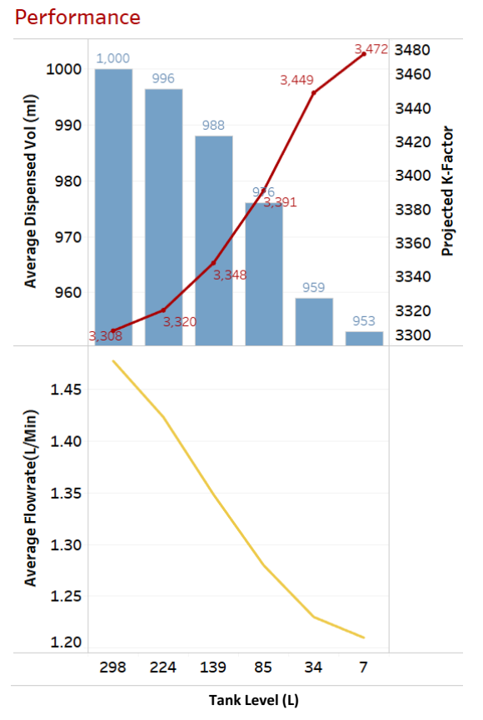
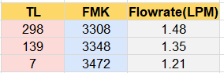
Test Setup 3 Results
KP exhibits the same performance profile as that of a normally powered pump
FMK increases with decrease in TL (decrease in flowrate)
Dispensed volume decreases with decrease in TL/flowrate
FMK change from full TL to 7L

Slide 26
Test Conclusions
Component wear and tear test
Even after 6700L, the flowmeter remained accurate (within 1000 ± 20ml MPE) and flowrate generally dropped
There was a small decrease (38) in FMK.
Current consumption of the DV and pump remained nearly constant throughout the test.
Component (DV, pump and flowmeter) wear and tear cannot be directly attributed to the cases of KP dispense accuracy non conformance.

Slide 27
Test Conclusions
Flowmeter performance vs flowrates (TL) test
FMK increases with decrease in KP tank level/flowrate hence higher chances of overdispense when KP is full vs underdispense when nearly empty.
Regardless of the calibration TL, a KP has high chance of overdispense or underdispense along the TL profile.
FMK change and volumes outside MPE is greater in KP-0751 than in KP-0550.
The FMK change experienced in the test (when KP flowmeter is powered by 5V DC) contradicts the manufacturer expectations of approx 8 pulses change between 1.0LPM to 1.9LPM.
When the KP flowmeter is powered by 12V DC, the max change in FMK recorded is 22 from 1.13LPM to 1.42LPM.

Slide 28
Test Conclusions
Component noise and power test
When the KP pump is powered externally, the performance profile is similar to when the pump is powered as designed, eliminating the pump suspected cause of noise during a dispense hence affecting the flowmeter.

Slide 29
Recommendations
Roll out modified 12V DC flowmeter supply BL PCBs to selected field KPs for further testing and observations.
To be done with Salim Faraja.
Revisit and analyze the KPC power circuits and components design.
Test the effect of a large capacitor across the flowmeter 5V pins

Slide 30
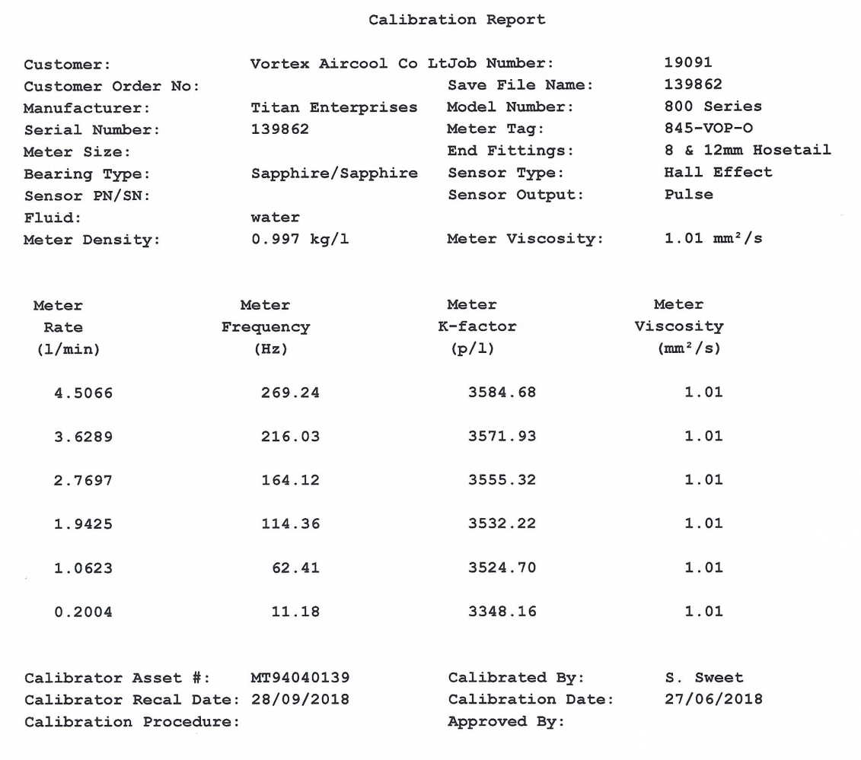
Appendix
Typical calibration curve for the KP Flowmeter

